Slide 1

Lecture 6: From SOTA Models to Transfer Learning across Tasks
AC295
AC295
Advanced Practical Data Science
Pavlos Protopapas

Slide 2
Outline
1: Communications and Recap
2: SOTA Deep Models
3: Transfer Learning across Tasks
Segmentation

Slide 3
Communications
Practicum 2:

Slide 4
Recap
Basics of Transfer Learning

Slide 5
Transfer Learning To The Rescue
• Train on a big "source" data set, with a big model, on one particular downstream tasks (say classification). Do it once and save the parameters. This is called a pre-trained model.
• Use these parameters for other smaller "target " datasets, say, for classification on new images (possibly different domain, or training distribution), or for image segmentation on old images(new task), or new images (new task and new domain).
• Will fail if source domain (where you trained big model) has nothing in common with target domain (that you want to train on smaller data set).

Slide 6
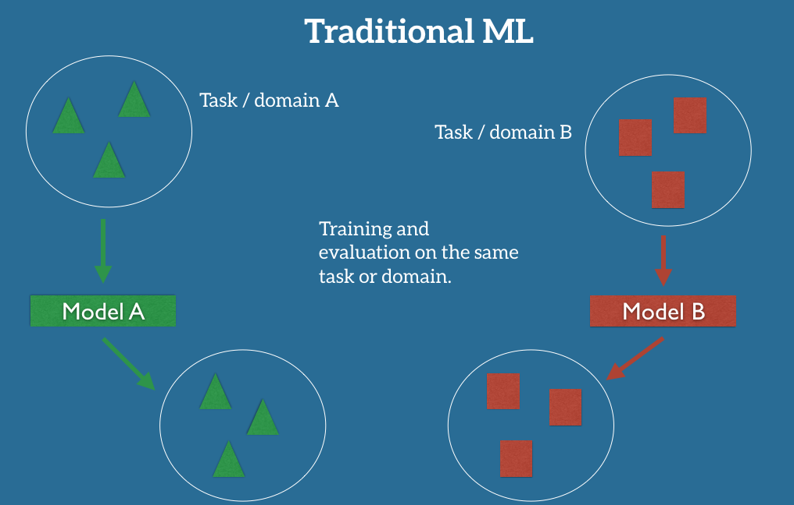
Transfer Learning

Slide 7
Outline
1: Communications and Recap
2: SOTA Deep Models
3: Transfer Learning across Tasks

Slide 8
SOTA Deep Models: Initial Ideas
The first piece of research proposing something similar to a Convolutional Neural Network was authored by Kunihiko Fukushima in 1980 and was called the NeoCognitron¹.
Inspired by discoveries on visual cortex of mammals.
End of the 80’s: several papers advanced the field
Backpropagation published Yann LeCun in 1985 (independently by other researchers as well)
TDNN by Waiber et al., 1989 - Convolutional-like network trained with backprop.
Backpropagation applied to handwritten zip code recognition by LeCun et al., 1989
¹ K. Fukushima. Neocognitron: A self-organizing neural network model for a mechanism of pattern recognition unaffected by shift in position. Biological Cybernetics, 36(4): 93-202, 1980.

Slide 9
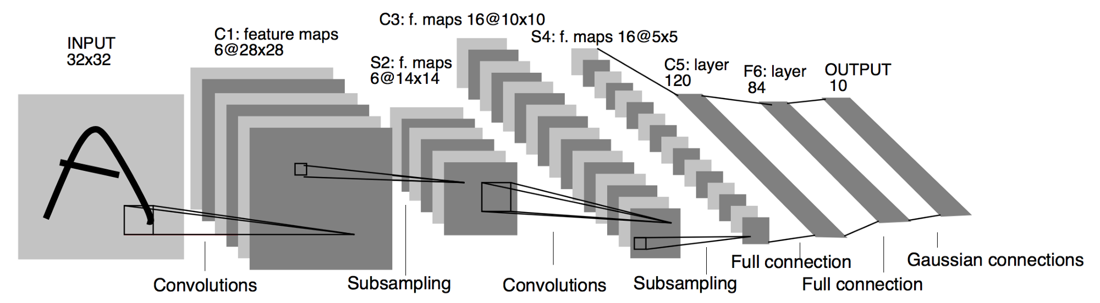
SOTA Deep Models: LeNet
In 1998 LeCun publishes one of his most recognized papers describing a “modern” CNN architecture for document recognition, called LeNet². Not his first iteration, this was indeed LeNet-5.
² LeCun, Yann, et al. "Gradient-based learning applied to document recognition." Proceedings of the IEEE 86.11 (1998): 2278-2324.

Slide 10
SOTA Deep Models: AlexNet
Developed by Alex Krizhevsky, Ilya Sutskever and Geoffrey Hinton at Utoronto in 2012. More than 25000 citations.
Destroyed the competition in the 2012 ImageNet Large Scale Visual Recognition Challenge. Showed benefits of CNNs and kickstarted AI revolution.
Main contributions:
Trained on ImageNet with data augmentation.
Increased depth of model, GPU training (5/6 days).
Smart optimizer and Dropout layers.
ReLU activation!

Slide 11

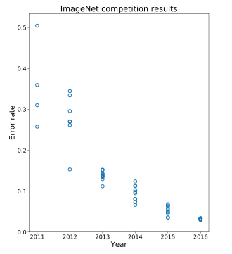
SOTA Deep Models: AlexNet <cont>
AlexNet
https://papers.nips.cc/paper/4824-imagenet-classification-with-deep-convolutional-neural-networks.pdf

Slide 12
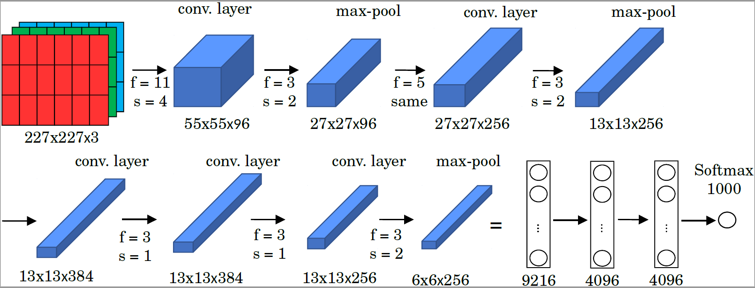
SOTA Deep Models: AlexNet <cont>
Trained on 1.2 million high-resolution (227x227x3) images in the ImageNet 2012 contest;
1000 different classes, NN with 60 million parameters to optimize (~ 255 MB).

Slide 13
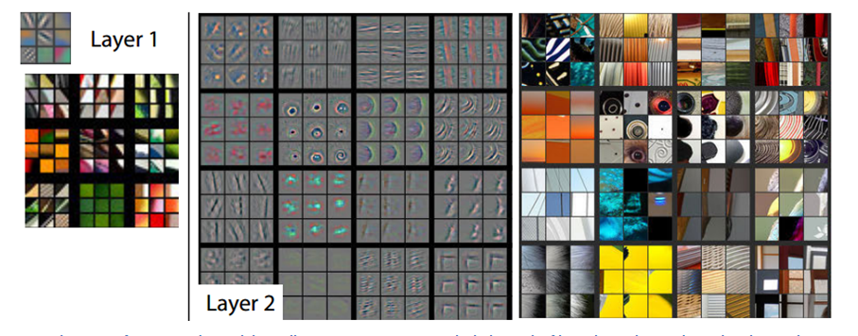
SOTA Deep Models: ZFNet
Introduced by Matthew Zeiler and Rob Fergus from NYU, won ILSVRC 2013 with 11.2% error rate. Decreased sizes of filters.
Paper presented a visualization technique named Deconvolutional Network, which helps to examine different feature activations and their relation to the input space. Trained for 12 days.
ZFNet

Slide 14

SOTA Deep Models: VGG16
Introduced by Simonyan and Zisserman in 2014
Simplicity and depth as main points
Uses 3x3 filters exclusively and 2x2 MaxPool layers with stride 2
Showed that two 3x3 filters have an effective receptive field of 5x5
As spatial size decreases, depth increases
Trained for 2/3 weeks
Still used as of today
VGG16
https://arxiv.org/pdf/1409.1556.pdf

Slide 15
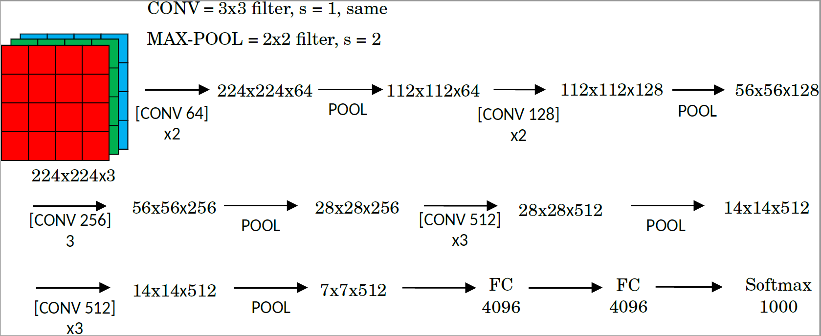
SOTA Deep Models: VGG
ImageNet Challenge 2014; 16 or 19 layers; 138 million parameters (~ 522 MB).
Convolutional layers use 3x3 filters with ‘same’ padding and stride 1.
Max-pooling layers use a filter size 2x2 and stride 2.

Slide 16
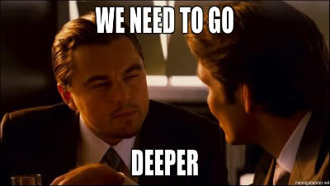

Slide 17
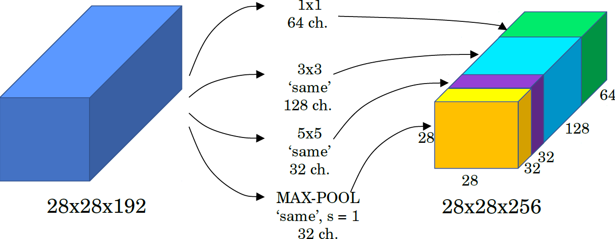
SOTA Deep Models: Inception (GoogLeNet)
The motivation behind inception networks is to use more than a single type of convolution layer at each layer.
Use 1 x 1, 3 x 3, 5 x5 convolutional layers, and max-pooling layers in parallel.
All modules use same convolution.
https://arxiv.org/pdf/1409.4842.pdf

Slide 18
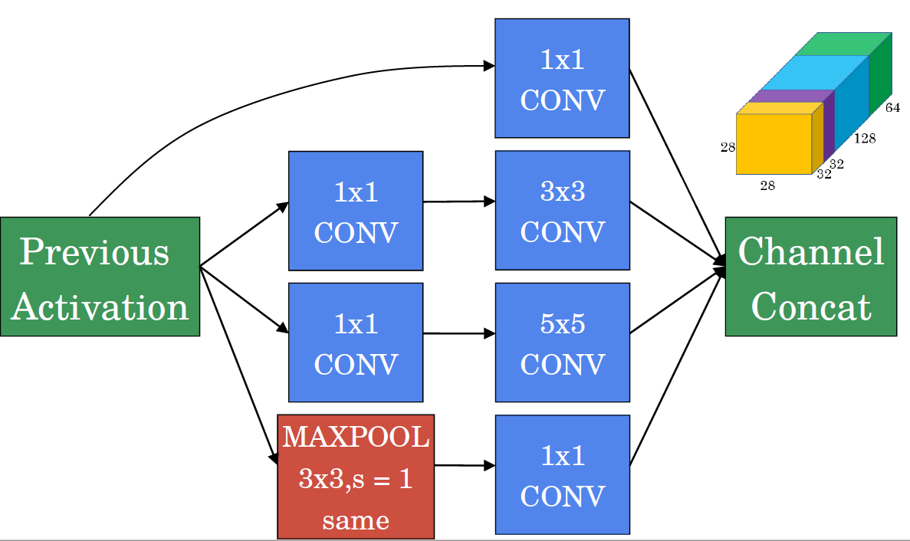
SOTA Deep Models: Inception (GoogLeNet)
Use 1 x 1 convolutions that reduce the size of the channel dimension.
The number of channels can vary from the input to the output.

Slide 19
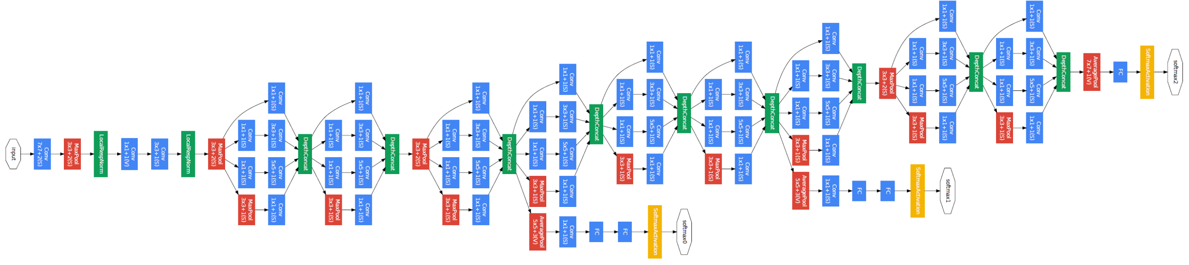
SOTA Deep Models: Inception (GoogLeNet)
The inception network is formed by concatenating other inception modules.
module8
module9
module7
module5
module6
module1
module2
module3
module4

Slide 20
SOTA Deep Models: Inception (GoogLeNet)
It includes several auxiliary softmax output units to t to combat the vanishing gradient It includes several auxiliary softmax output units to t to combat the vanishing gradient problem while providing regularization.
Auxiliary networks are not used during prediction.
module8
module9
module7
module5
module6
module1
module2
module3
module4
softmax2
softmax1

Slide 21
SOTA Deep Models: MobileNet
Presented by Howard et al. (Google), 2017;
The MobileNet model is based on depthwise separable convolutions (DW)
DW factorize a standard convolution into a depthwise convolution and a 1×1 convolution called a pointwise convolution.
Standard Convolution
Depth-Wise Separable Convolution (DW)
3x3 Conv
3x3 Conv
Batch Norm
Batch Norm
ReLU
ReLU
1x1 Conv
Batch Norm
ReLU
https://arxiv.org/pdf/1704.04861.pdf
Fig. Left: Standard convolutional layer with batchnorm and ReLU. Right Depthwise Separable convolutions with Depthwise and pointwise layers followed by batchbnorm and ReLU

Slide 22
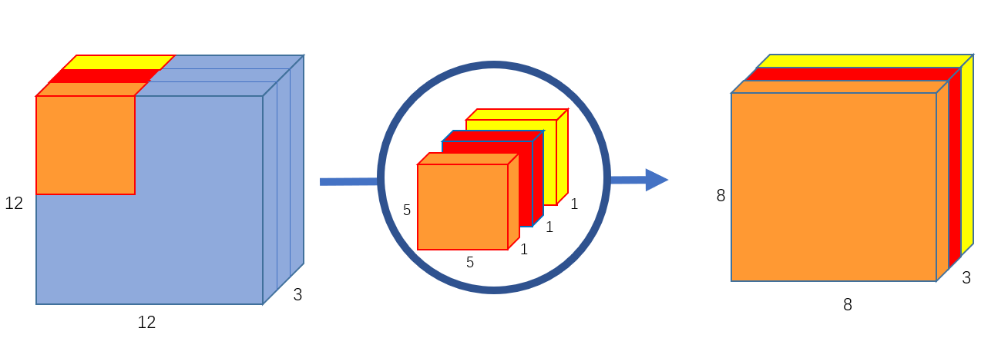
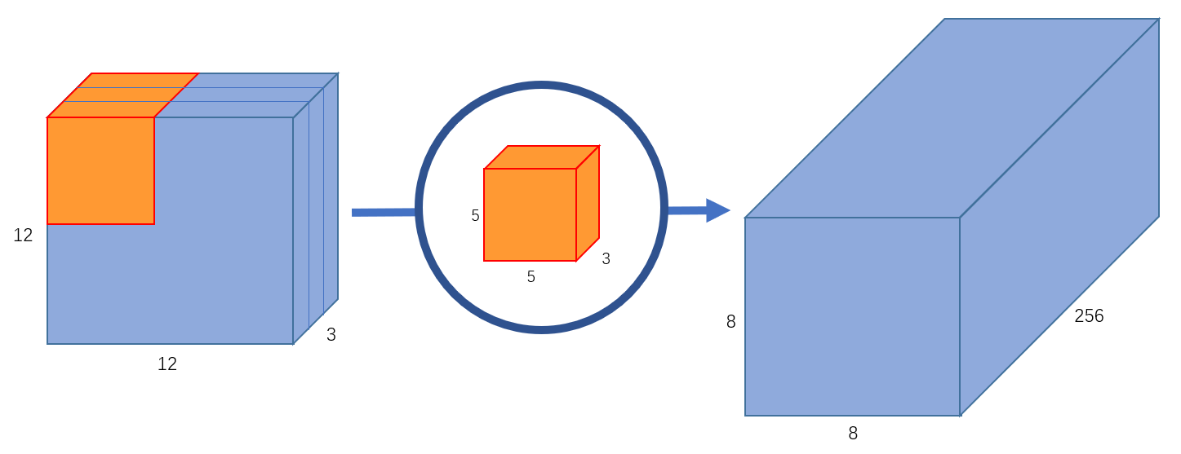
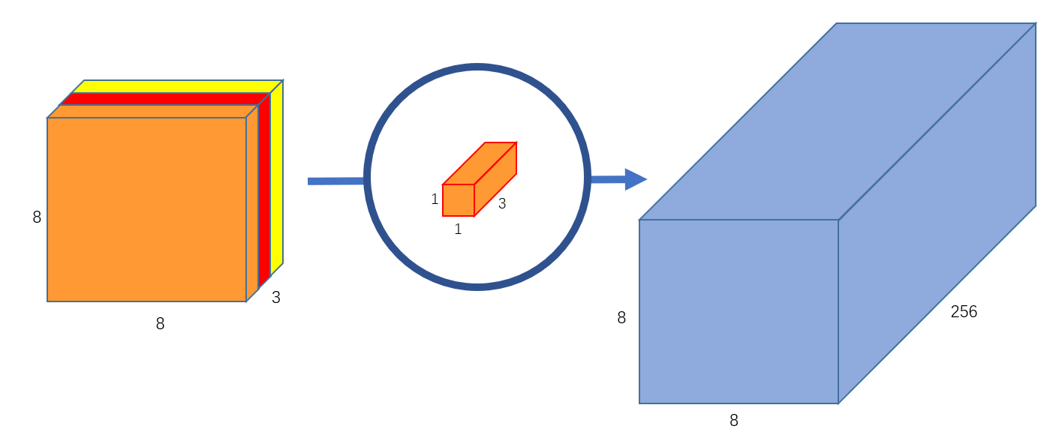
MobileNet <cont>
Standard Convolution
Depth-Wise Separable Convolution (DW)
Filters and combines inputs into a new set of outputs in one step
Input: 12x12x3
Filter: 5x5x3
Output: 8x8x3
(no padding)
Depth-Wise Separable Convolution (DW)
Input: 12x12x3
Filter: 5x5x3x256
Output: 8x8x256
(no padding)
Input: 8x8x3
Filter: 1x1x3x256
Output: 8x8x256
(no padding)
MACs: (5x5)x3x256x(12x12) ~ 2.8M
Parameters: (5x5x3)x256 + 256 ~ 20K
MACs: (5x5)x3x(12x12) + 3x256x(8x8) ~ 60K
Parameters: (5x5x3 + 3) + (1x1x3x256+256) ~ 1K

Slide 23
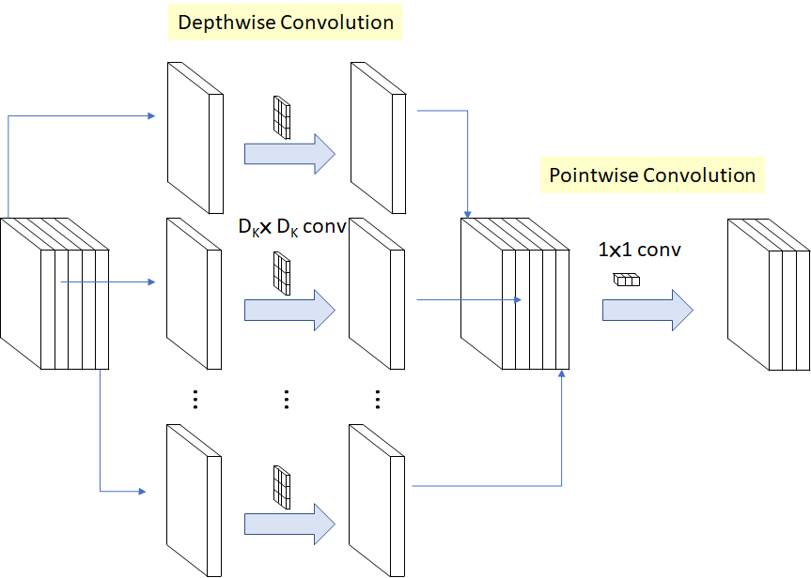
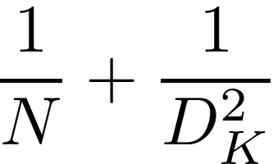
SOTA Deep Models: MobileNet <cont>
Computation Reduction
M: input channels
N: output channels.
DK: the filter (kernel) size
DF: the feature map size
The computation Reduction comparing to standard convolution is

Slide 24
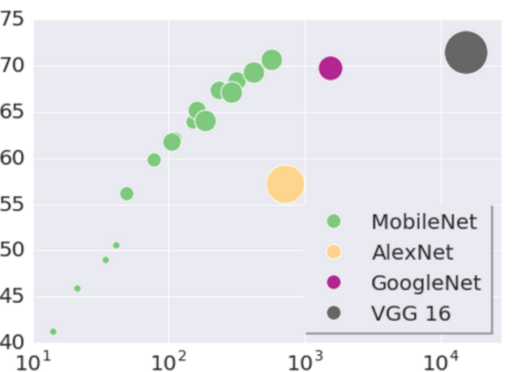
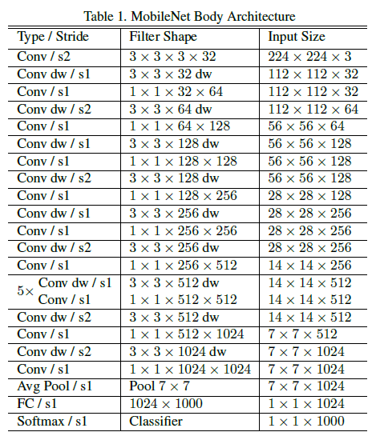
SOTA Deep Models: MobileNet <cont>
ImageNet Top-1 Accuracy (%)
MACs: Multiply-Accumulates (#operations)
MobileNets: Efficient Convolutional Neural Networks for Mobile Vision Applications (arXiv.1704.04861)

Slide 25


Slide 26
SOTA Deep Models: ResNet

Slide 27
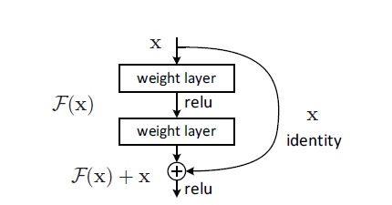
SOTA Deep Models: ResNet
Presented by He et al. (Microsoft), 2015. Won ILSVRC 2015 in multiple categories.
Main idea: residual block that allows for extremely deep networks.
It is easier to optimize the residual mapping than the original one. Furthermore, residual block can decide to “shut itself down” if needed.

Slide 28
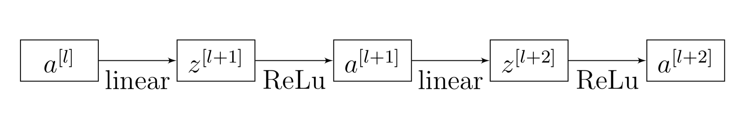
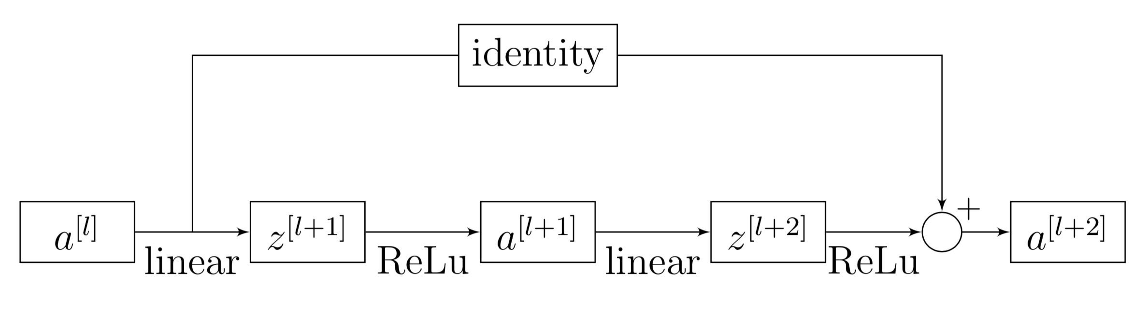
SOTA Deep Models: ResNet <cont>
Network structure a) without and b) with “Residual Block”
a)
b)
Original idea in Highway Networks: https://arxiv.org/pdf/1505.00387.pdf

Slide 29
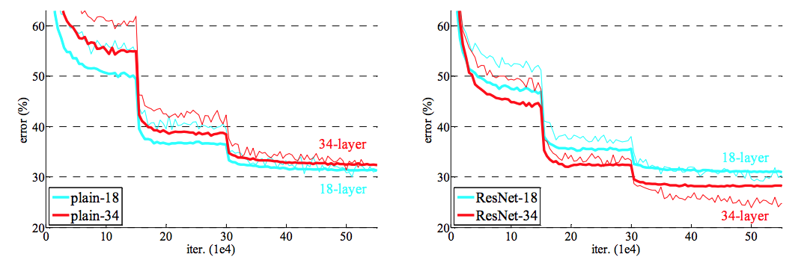
SOTA Deep Models: ResNet <cont>
The residual network stacks blocks sequentially (fig. a);
The network become deeper without increasing the training time (fig. b).
a)
b)

Slide 30
Deep Models: ResNet <cont>
Residual networks implement blocks with convolutional layers that use ‘same’ padding option (even when max-pooling). This allows the block to learn the identity function;
The designer may want to reduce the size of features and use ‘valid’ padding. In such case, the shortcut path can implement a new set of convolutional layers that reduces the size appropriately.
Number of Layers | Number of Parameters
ResNet 18 | 11.174M
ResNet 34 | 21.282M
ResNet 50 | 23.521M
ResNet 101 | 42.513M
ResNet 152 | 58.157M

Slide 31
SOTA Deep Models: ResNet <cont>
Networks comparison: ResNet34 (top), ResNet34 “Without Residual Blocks” (middle), VGG-19 (bottom).

Slide 32
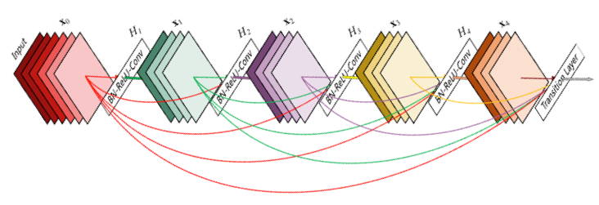
SOTA Deep Models: DenseNets
Motivation: to allow maximum information (and gradient) flow to connect every layer directly with each other.
Connect every layer directly with each other.
DenseNets concatenates outputs from the previous layers instead of using the summation.
DenseNets layers are very narrow (e.g. 12 filters), and they just add a small set of new feature-maps.
https://arxiv.org/pdf/1608.06993v3.pdf

Slide 33
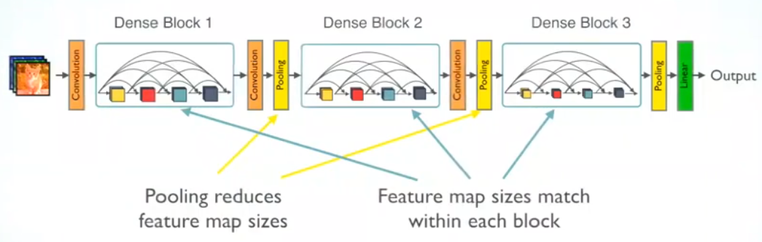
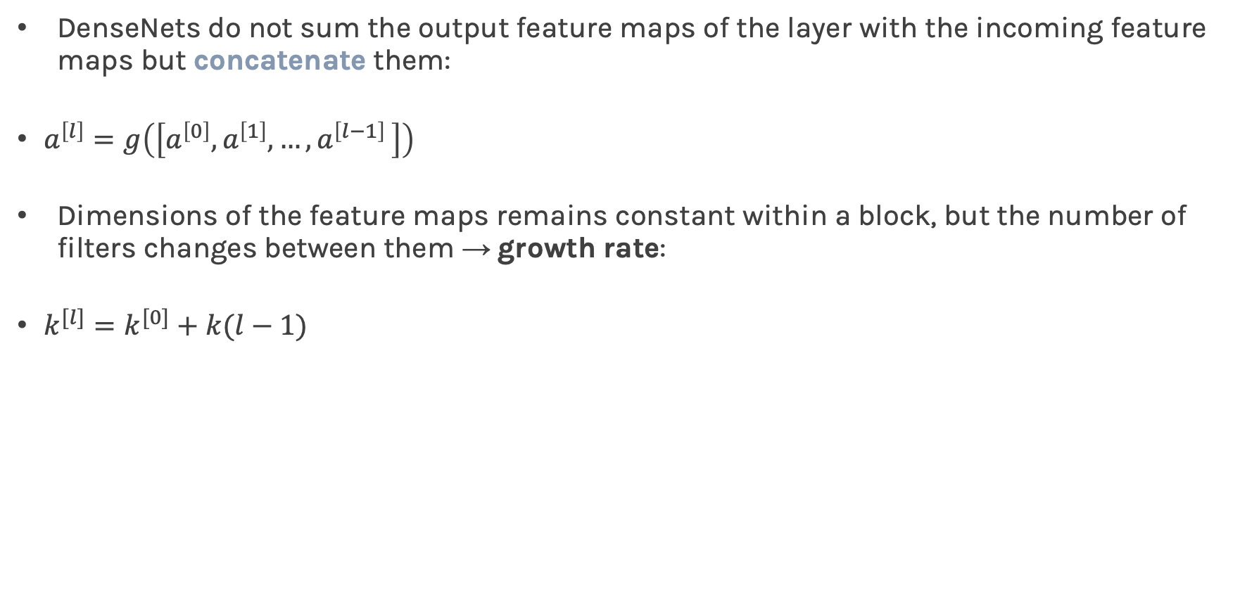
DenseNets do not sum the output feature maps of the layer with the incoming feature maps but concatenate them:
$a^{\left[l\right]}=g\left(\left[a^{\left[0\right]}, a^{\left[1\right]}, {…, a}^{\left[l−1\right]}\right]\right)$
Dimensions of the feature maps remains constant within a block, but the number of filters changes between them → growth rate:
$k^{[l]}=k^{[0]}+k(l−1)$
https://towardsdatascience.com/review-densenet-image-classification-b6631a8ef803

Slide 34
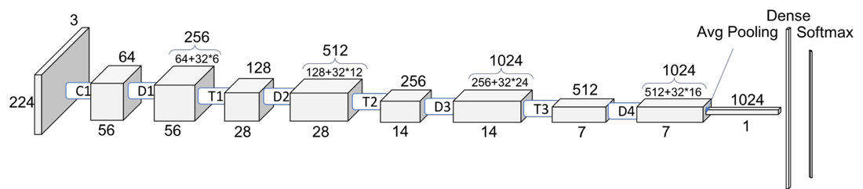
SOTA Deep Models: DenseNets

Slide 35
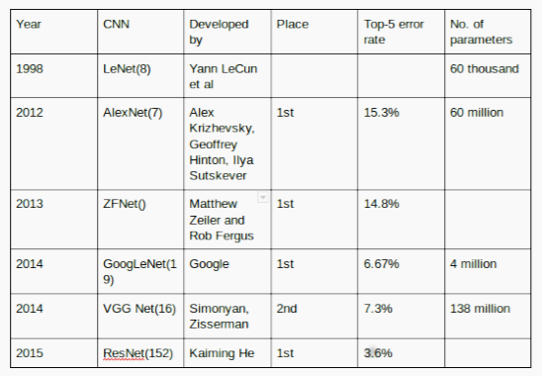
SOTA Deep Models: Summary Networks
We are now reaching top-5 error rates lower than human manual classification.

Slide 36
SOTA Deep Models and Beyond
MobileNetV2 and V3 (https://arxiv.org/abs/1801.04381, https://arxiv.org/abs/1905.02244)
Inception-Resnet, v1 and v2 (https://arxiv.org/abs/1602.07261)
Wide-Resnet (https://arxiv.org/abs/1605.07146)
Xception (https://arxiv.org/pdf/1610.02357v2.pdf)
ResNeXt (https://arxiv.org/pdf/1611.05431)
ShuffleNet, v1 and v2 (https://arxiv.org/abs/1707.01083)
Squeeze and Excitation Nets (https://arxiv.org/abs/1709.01507 )
Deep Pyramidal Residual Networks (https://arxiv.org/pdf/1610.02915.pdf)
FractalNet (https://arxiv.org/pdf/1605.07648.pdf)

Slide 37
Outline
1: Communications and Recap
2: SOTA Deep Models
3: Transfer Learning across Tasks

Slide 38
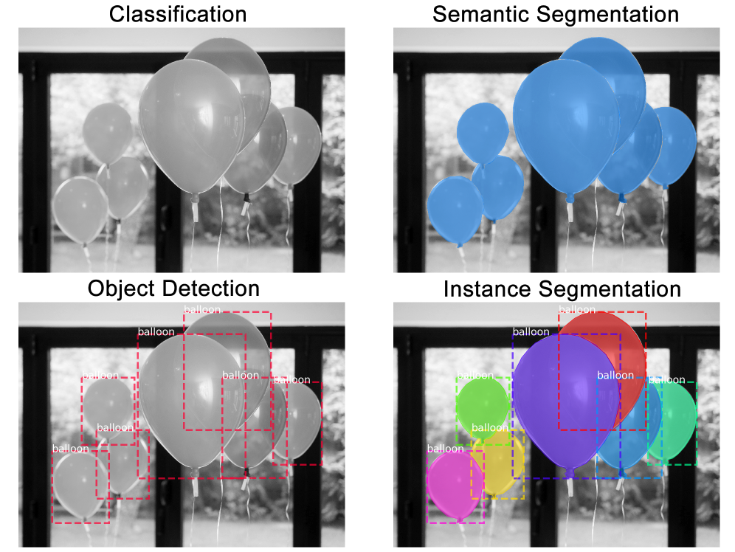
Tasks

Slide 39
Outline: Semantic Segmentation and Object Detection
Object Detection: let’s classify and locate
Sliding Window versus Region Proposals
Two stage detectors: the evolution of R-CNN , Fast R-CNN, Faster R-CNN
Single stage detectors: detection without Region Proposals: YOLO / SSD
Semantic segmentation: classify every pixel
Fully-Convolutional Networks
SegNet & U-NET
Faster R-CNN linked to Semantic Segmentation: Mask R-CNN
Demo: Using Transfer-Learning to train a U-NET

Slide 40
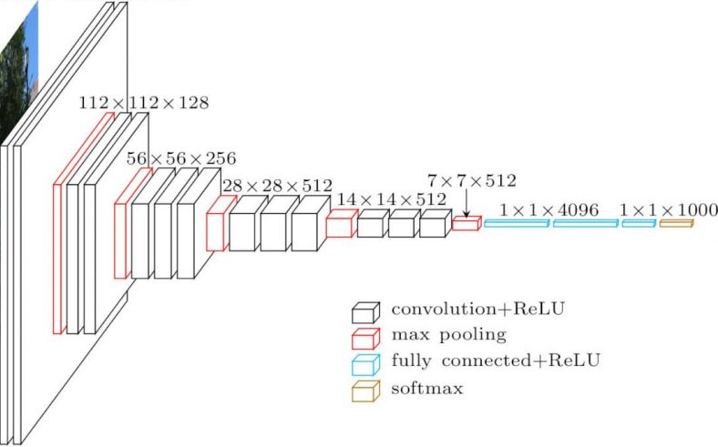
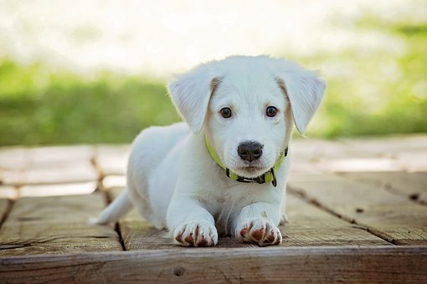
Tasks: Image Classification: Fully-Connected CNN
Fundamental to computer vision given a set of labels {dog, cat, human, ...};
Predict the most likely class.
Input
VGG
Output
Classification (C = 1000):
Dog: 0.95
Cat: 0.02
Human: 0.01
...

Slide 41
Tasks: From Classification to Classification + Localization
Localization demands to compute where 1 object is present in an image;
Limitation: only 1 object (also non-overlapping);
Typically implemented using a bounding box (x, y, w, h).
Predict
Predict
Classification Output:
Dog: 0.95
Cat: 0.02
Human: 0.01
...
Classification output:
Dog: 0.95
Cat: 0.02
Human: 0.01
Localization output:
Bounding-Box:
(x, y, w, h)
Output: Regular Image Classification

Slide 42
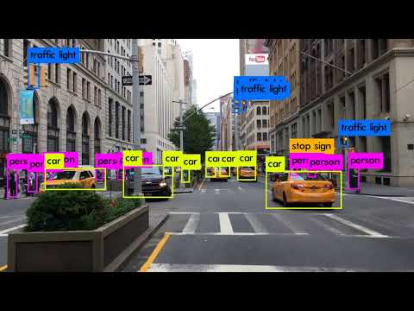
Tasks: From Classification + Localization to Object Detection
Classification and Localization extended to multiple objects
Youtube ‘YOLO in New York” by Joseph Redmon (creator of YOLO)

Slide 43
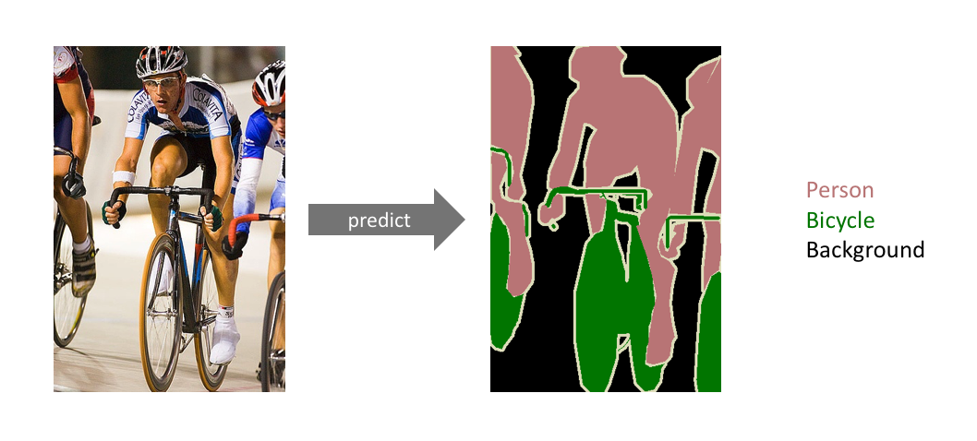
Tasks: From Classification to Semantic Segmentation
Image Classification: assigning a single label to the entire picture
Semantic segmentation: assigning a semantically meaningful label to every pixel in the image
Long, Shelhamer et al. “Fully Convolutional Networks for Semantic Segmentation”, CVPR 2015 : Cited by 14480

Slide 44
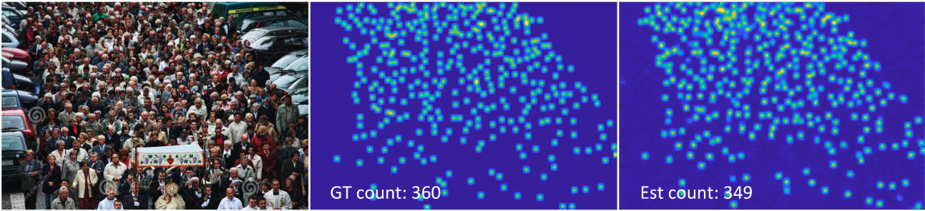
Why Object Detection and Semantic Segmentation
Computer vision:
Autonomous vehicles
Biomedical Imaging detecting cancer, diseases
Video surveillance:
Counting people
Tracking people
Aerial surveillance
Geo Sensing: tracking wildfire, glaciers, via satellite
Note:
Efficiency/inference-time is important!
How many frames/sec. can we predict?
Must for real-time segmentation & detection.

Slide 45
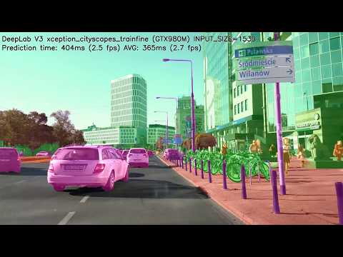
Why Object Detection and Semantic Segmentation
Youtube: “Tensorflow DeepLab v3 Xception Cityscapes”(link )

Slide 46
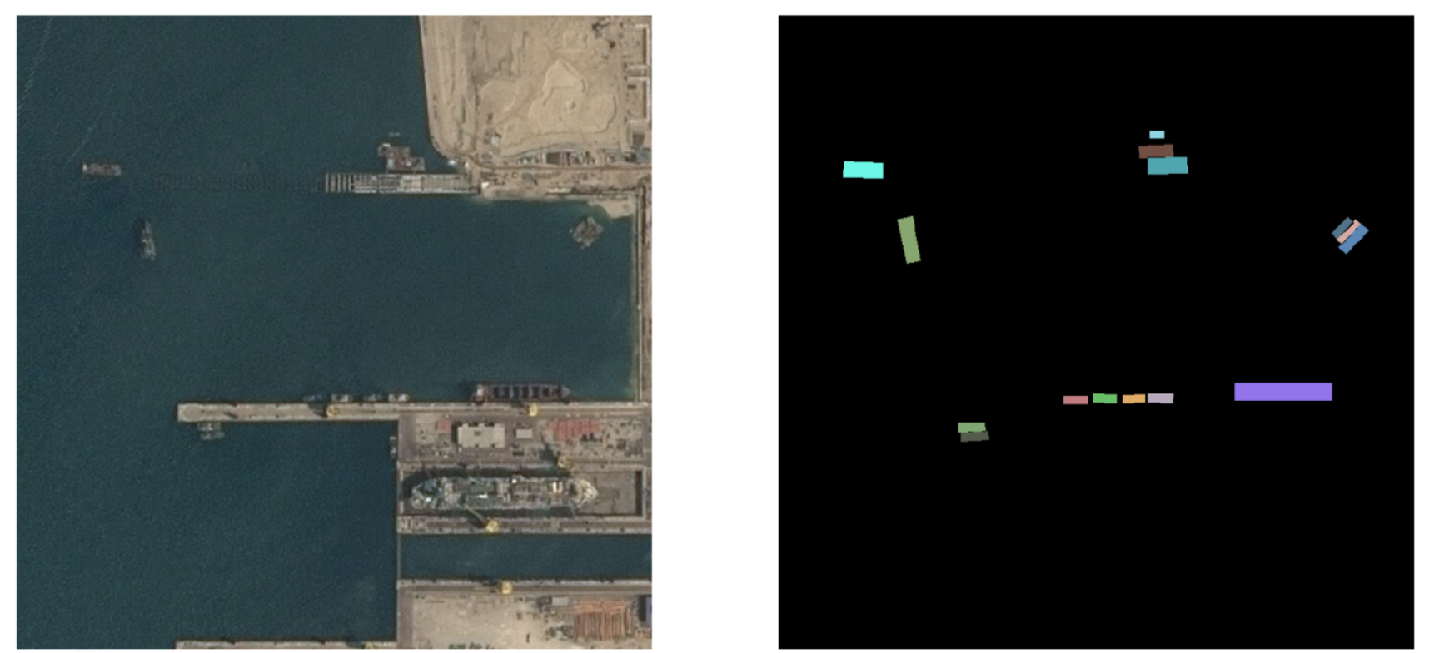

How to measure quality in detection and segmentation?
Pixel Accuracy:
Percent of pixels in your image that are classified correctly
Our model has 95% accuracy! Great!
Input
Labels
Predict
Image from Vlad Shmyhlo in article: Image Segmentation: Kaggle experience in TDS
Problem with accuracy: unbalanced data!

Slide 47
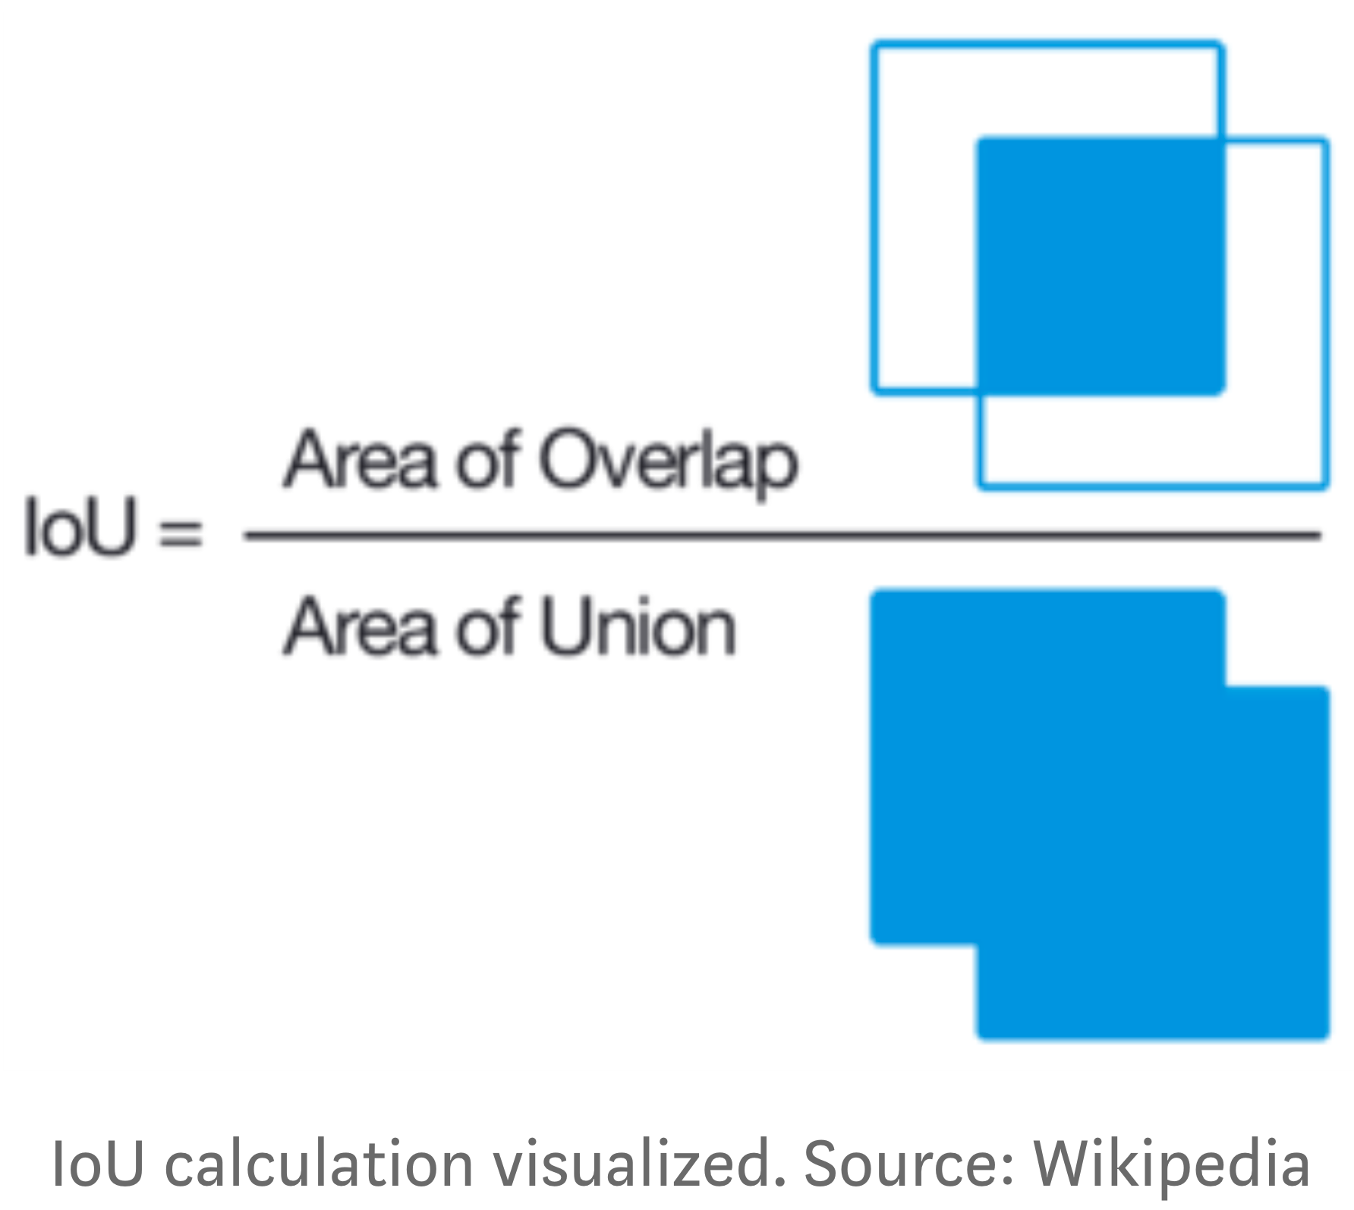
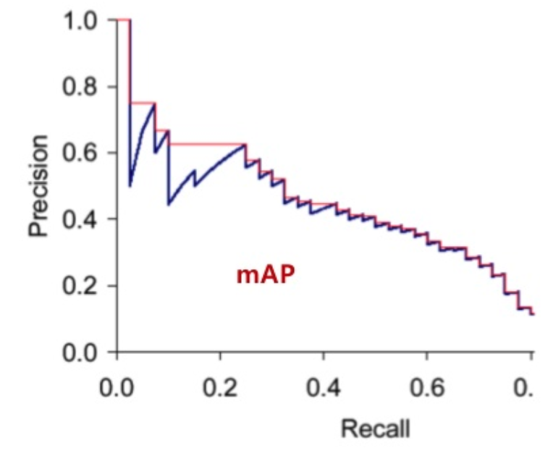
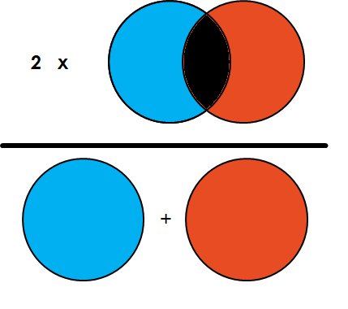
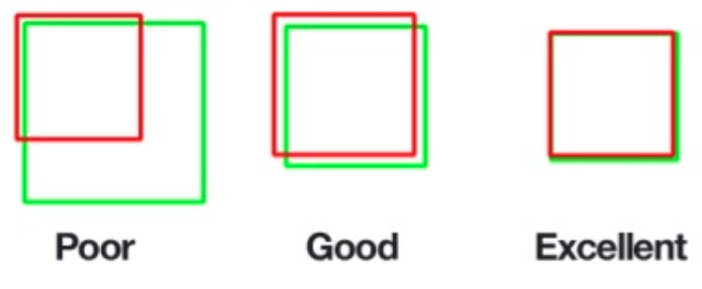
How do we measure accuracy?
Pixel Accuracy: Percent of pixels in your image that are classified correctly
IOU: Intersection-Over-Union (Jaccard Index): Overlap / Union
DICE: Coefficient (F1 Score): 2 x Overlap / Total number of pixels
mAP: Mean Average Precision: AUC of Precision-Recall curve standard (0.5 is high)
IOU
mAP
DICE
IoU: 0.40
IoU: 0.73
IoU: 0.92

Slide 48
Outline: Semantic Segmentation and Object Detection
Object Detection: let’s classify and locate
Sliding Window versus Region Proposals
Two stage detectors: the evolution of R-CNN , Fast R-CNN, Faster R-CNN
Single stage detectors: detection without Region Proposals: YOLO / SSD
Semantic segmentation: classify every pixel
Fully-Convolutional Networks
SegNet & U-NET
Faster R-CNN linked to Semantic Segmentation: Mask R-CNN
Demo: Using Transfer-Learning to train a U-NET

Slide 49
Object detection: let’s classify and locate
Object detection is just classification and localization combined:
Classification using standard CNN;
Localization using regression problem for predicting box coordinates
Combining loss from Classification (Softmax) and Regression (L2)
Input
VGG
Output
Classification:
Dog: 0.95
Cat: 0.02
Human: 0.01
...
Multi-Task
Learning
Softmax
Loss
Bounding-Box :
x
y
width (w)
height (h)
L2-norm
Loss

Slide 50
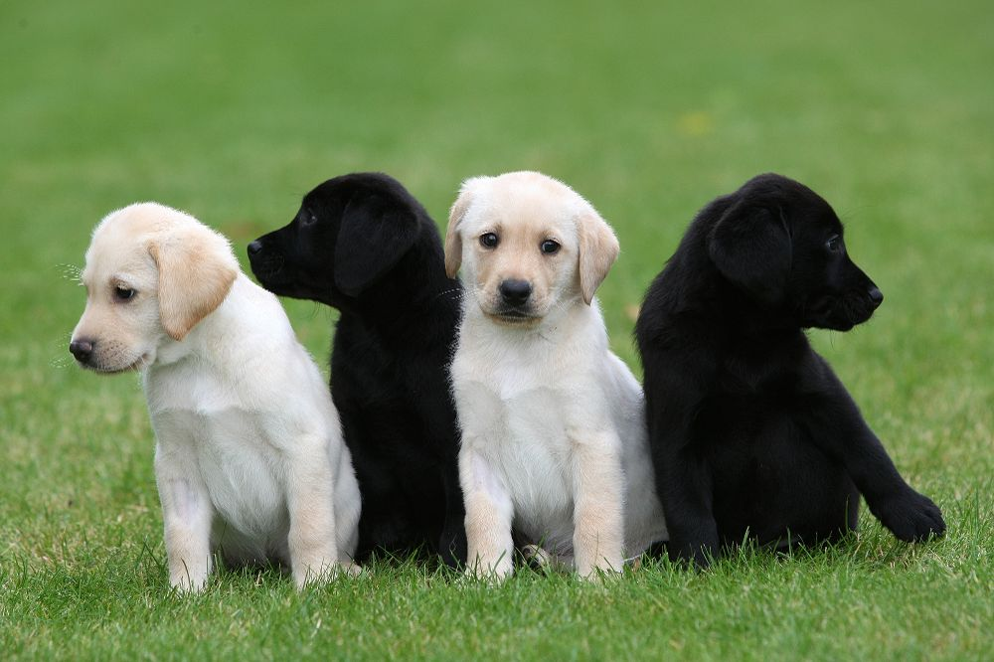
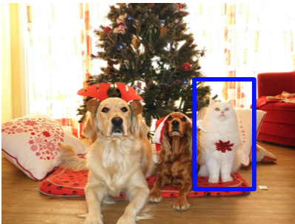
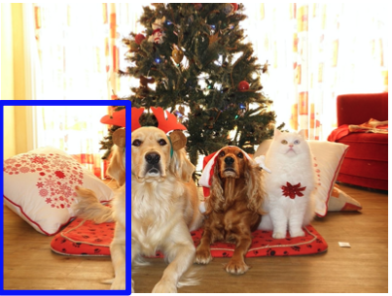
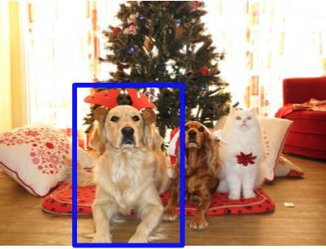
Sliding Windows, from single to multiple objects
Might work for single object, but not for multiple objects
Each image containing “x” objects: needs “x” number of classification and localization outputs
Solution for multiple objects:
Crop the image “in a smart way”
Apply the CNN to each crop
Can we just use sliding windows?
Problem: Need for applying CNN to huge number of locations, scales, bbox aspect ratios: very computationally expensive;
Solution: Region Proposals methods to find object-like regions.
Dog: (x, y, w, h )
Dog: (x, y, w, h )
Dog: (x, y, w, h )
Dog: (x, y, w, h )
Dog: (x, y, w, h )
Adapted from Fei-Fei Li & Justin Johnson & Serena Yeung Stanford CS231n 2019 “Convolutional Neural Networks for Visual Recognition” Lecture 12 Slide 37
Uijlings et al, Selective Search for Object Recognition” IJCV 2013 link

Slide 51
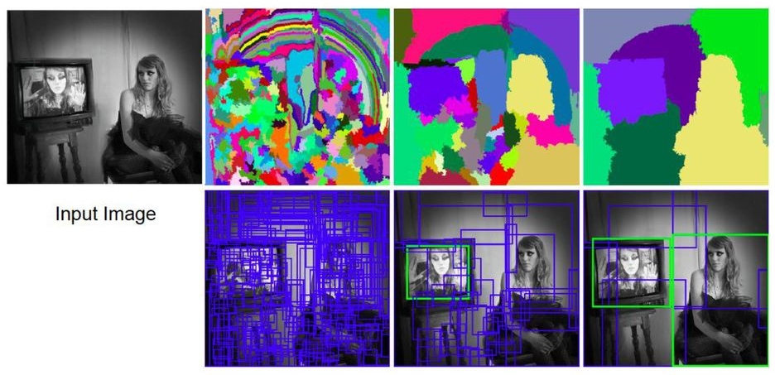
Object detection: Region Proposal Networks!
Problem: Need for applying CNN to huge number of locations, scales, bbox aspect ratios, very computationally expensive!
Solution: Region Proposals methods to find object-like regions:
Selective Search Algorithm: returns boxes that are likely to contain objects:
Use hierarchical segmentation;
Start with small superpixels;
Merge based on similarity.
Output: Where are object like regions?
No classification yet.
Uijlings et al, Selective Search for Object Recognition” IJCV 2013 link

Slide 52
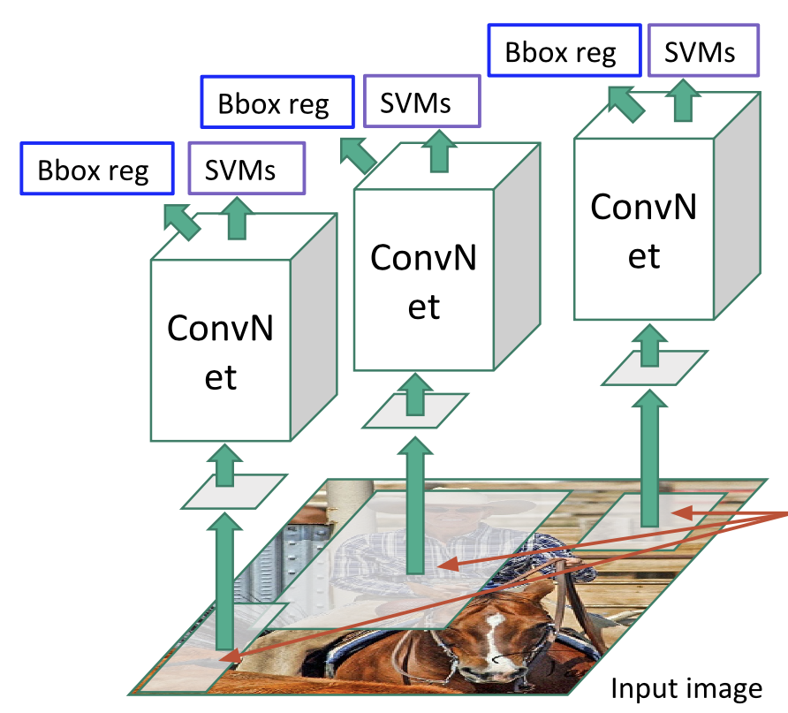
The Evolution of R-CNN: R-CNN, Fast R-CNN, Faster R-CNN
R-CNN = Region-based CNN
Correct BBox by Bbox regressor (dx,dy,dw,dh)
Forward each region through CNN
Resize proposed RoI (224x224)
Region of Interest (RoI) from selective search region proposal (approx 2k)
Problem: need to do 2k independent forward passes for each image! (‘slow’ R-CNN)
Adapted from Fei-Fei Li & Justin Johnson & Serena Yeung Stanford CS231n 2019 “Convolutional Neural Networks for Visual Recognition”
Girshick et al, “Rich feature hierarchies for accurate object detection and semantic segmentation” CVPR2014
Ross Girshick, “Fast R-CNN” Slides 2015

Slide 53
The Evolution of R-CNN: R-CNN, Fast R-CNN, Faster R-CNN
R-CNN = Region-based CNN
Correct BBox by Bbox regressor (dx,dy,dw,dh)
Forward each region through CNN
Resize proposed RoI (224x224)
Region of Interest (RoI) from selective search region proposal (approx 2k)
Problem: need to do 2k independent forward passes for each image! (‘slow’ R-CNN)
Solution: can we process the image before cropping?
Adapted from Fei-Fei Li & Justin Johnson & Serena Yeung Stanford CS231n 2019 “Convolutional Neural Networks for Visual Recognition”
Girshick et al, “Rich feature hierarchies for accurate object detection and semantic segmentation” CVPR2014
Ross Girshick, “Fast R-CNN” Slides 2015

Slide 54
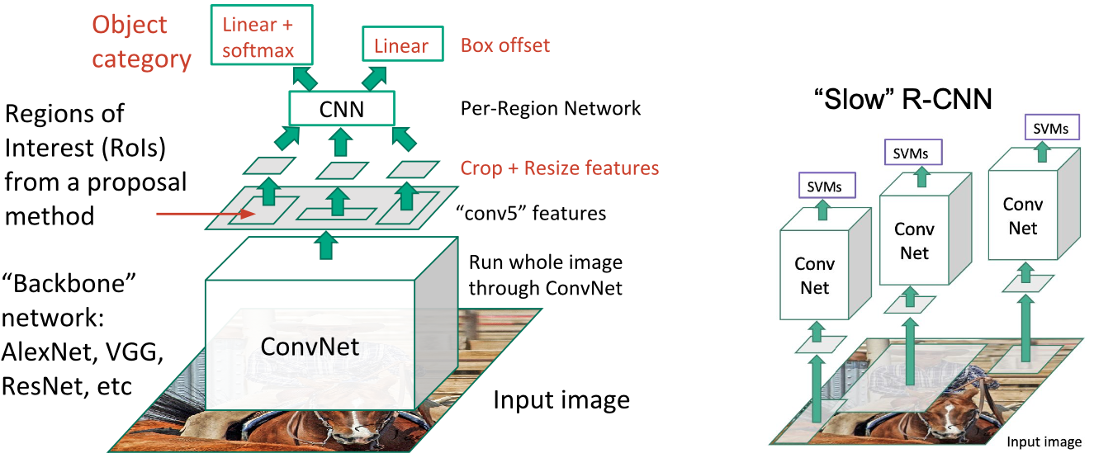
The Evolution of R-CNN: R-CNN, Fast R-CNN, Faster R-CNN
Problem: need to do 2k independent forward passes for each image! (‘slow’ R-CNN)
Even inference is slow: 47s/image with VGG16 [Simonyan & Zisserman, ICLR 15]
Solution: can we process (CNN forward pass) the image before cropping generates 2k regions?
Fast R-CNN
Slow R-CNN
Adapted from Fei-Fei Li & Justin Johnson & Serena Yeung Stanford CS231n 2019 “Convolutional Neural Networks for Visual Recognition”
Ross Girshick, “Fast R-CNN” Slides 2015

Slide 55
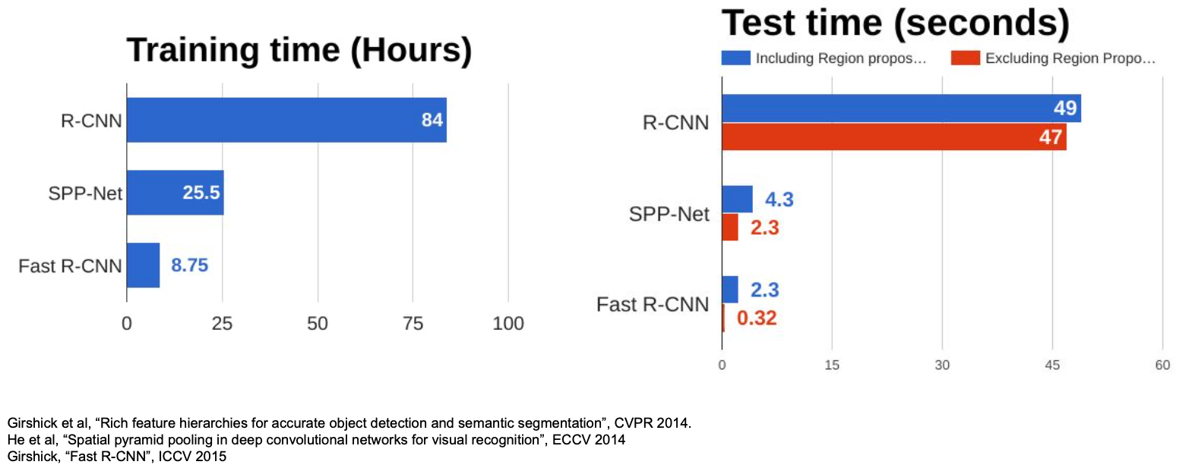
The Evolution of R-CNN: R-CNN, Fast R-CNN, Faster R-CNN
Fast R-CNN much faster than R-CNN;
Runtime dominated by region proposals; is an iterative method (‘like selective search’);
Solution: can we make CNN do proposals!
Training Time (Hours)
Test Time (Seconds)
Adapted from Fei-Fei Li & Justin Johnson & Serena Yeung Stanford CS231n 2019 “Convolutional Neural Networks for Visual Recognition”
Ross Girshick, “Fast R-CNN” Slides 2015

Slide 56
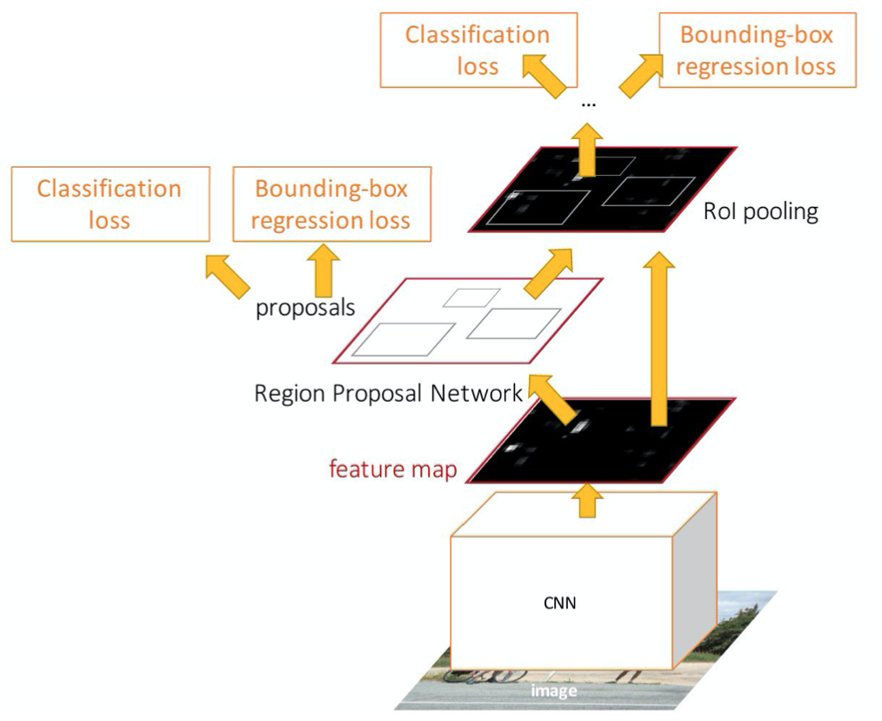
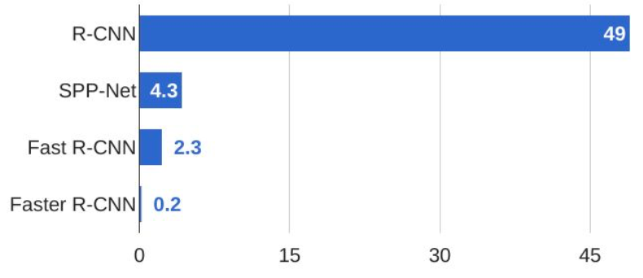
The Evolution of R-CNN: R-CNN, Fast R-CNN, Faster R-CNN
Faster R-CNN: make CNN to do proposals! (single forward, not iterative selective search)
CNN Region Proposal Network (RPN): predicting region proposals from features
Otherwise same as Fast R-CNN: crop and classify
End-to-end quadruple loss:
RPN classify object / not object
RPN regress box coordinates
Final classification score (object classes)
Final box coordinates
Test-time seconds per image:
Adapted from Fei-Fei Li & Justin Johnson & Serena Yeung Stanford CS231n 2019 “Convolutional Neural Networks for Visual Recognition”
Ross Girshick, “Fast R-CNN” Slides 2015

Slide 57
The Evolution of R-CNN: R-CNN, Fast R-CNN, Faster R-CNN
Previously we said: “Multiple objects? Thus Need for Region Proposal Networks!”
Faster R-CNN is a two-stage object detector
Stage 1: backbone network + RPN (once/image)
Stage 2: crop - predict object & bbox (once/region)
What is our RPN again?
RPN runs prediction on many many anchor boxes:
Loss 1: Tells is does the anchor bbox contain an object
Loss 2: For the top 300 boxes its adjusts the box
What is the difference between our 2 classification losses?
one is classifying object (i.e. object/not object) – green box
one is classifying specific categories (e.g. dog) – pink box
Do we really need two stages?
Stage 2
Stage 1
Adapted from Fei-Fei Li & Justin Johnson & Serena Yeung Stanford CS231n 2019 “Convolutional Neural Networks for Visual Recognition”
Ross Girshick, “Fast R-CNN” Slides 2015

Slide 58
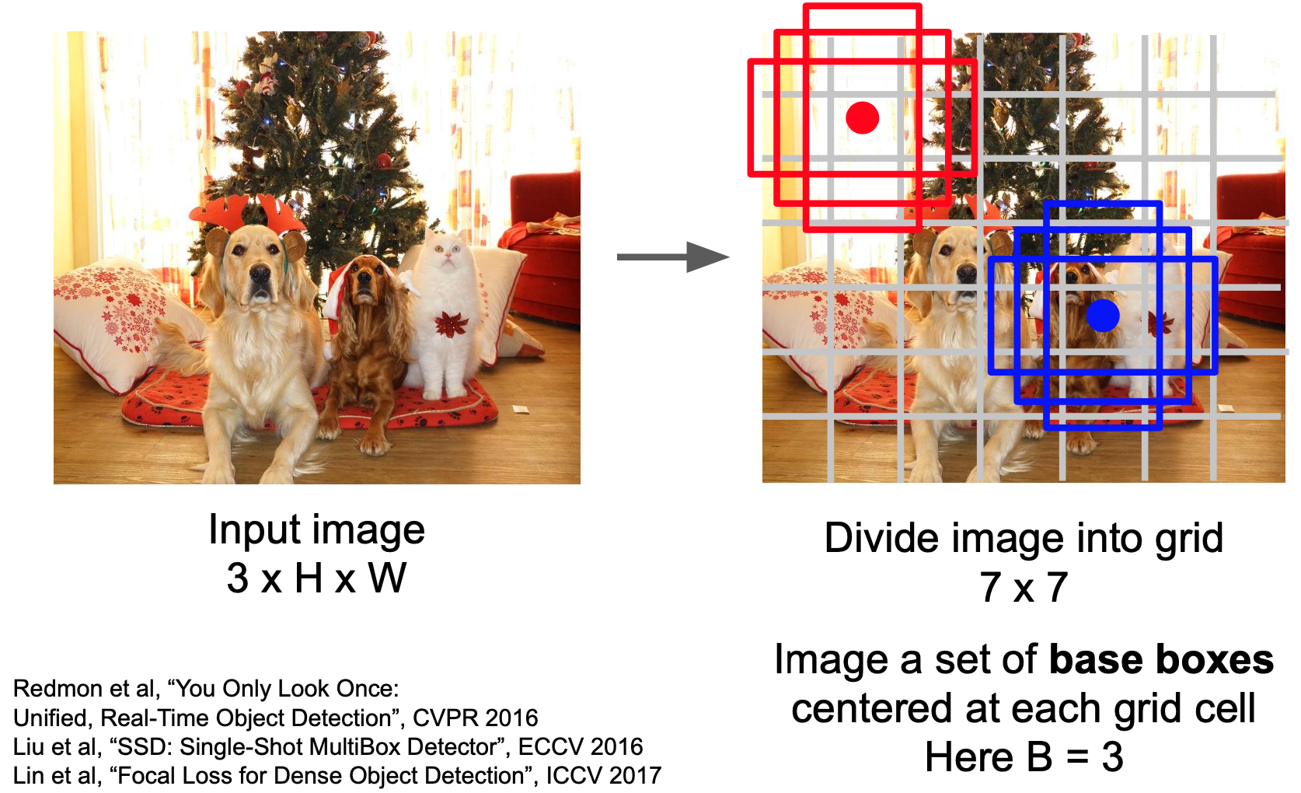
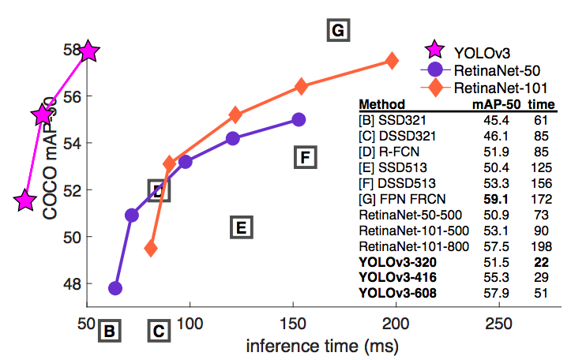
Single-Stage Detection without Region Proposals: YOLO, SSD
Within each of the NxN grid regress over each B base boxes, predict: (x,y,h,w, confidence = 5)
Predict C category specific class scores
Output : N x N x S ( 5 B + C)
YOLOv3 (Joseph Redmon):
predicts at 3 scales, S = 3
predicts 3 boxes at each scale, B=3
Darknet-53 as feature extractor (similar to ResNet 152, and 2x faster!)
(YOLO) Redmon, “You Only Look Once: Unified, Real-Time Object Detection” CVPR 2015: Cited by 8057 (link)
Fei-Fei Li & Justin Johnson & Serena Yeung Stanford CS231n 2019 “Convolutional Neural Networks for Visual Recognition”

Slide 59

Single-Stage Detection without Region Proposals: YOLO, SSD
Within each of the NxN grid regress over each B base boxes, predict: (x,y,h,w, confidence = 5)
Predict C category specific class scores
Output : N x N x S ( 5 B + C)
YOLOv3 (Joseph Redmon):
predicts at 3 scales, S = 3
predicts 3 boxes at each scale, B=3
Darknet-53 as feature extractor (similar to ResNet 152, and 2x faster!)
(YOLO) Redmon, “You Only Look Once: Unified, Real-Time Object Detection” CVPR 2015: Cited by 8057 (link)
Fei-Fei Li & Justin Johnson & Serena Yeung Stanford CS231n 2019 “Convolutional Neural Networks for Visual Recognition”

Slide 60

Exercise 1-4 vs Exercise 5

Slide 61
Outline: Semantic Segmentation and Object Detection
Object Detection: let’s classify and locate
Sliding Window versus Region Proposals
Two stage detectors: the evolution of R-CNN , Fast R-CNN, Faster R-CNN
Single stage detectors: detection without Region Proposals: YOLO / SSD
Semantic segmentation: classify every pixel
Fully-Convolutional Networks
SegNet & U-NET
Faster R-CNN linked to Semantic Segmentation: Mask R-CNN
Demo: Using Transfer-Learning to train a U-NET

Slide 62

Semantic segmentation: Classify every pixel
Image Classification: assigning a single label to the entire picture
Semantic segmentation: assigning a semantically meaningful label to every pixel in the image
So our output shouldn’t be a class prediction (C numbers) but a picture (C x w x h)
Can we have a network for each pixel location?
Sliding window inputs of patches predicting the class of the pixel in the center?
Many forward passes! Not reusing overlapping patches and features.
(FCN) Long, Shelhamer et al. “Fully Convolutional Networks for Semantic Segmentation”, CVPR 2015: Cited by 14480 (link)

Slide 63

Fully-Convolutional Networks
Semantic segmentation: assigning a semantically meaningful label to every pixel in the image
So our output shouldn’t be a classification prediction (C numbers) but a picture (C x w x h)
Maybe we can have a network for each pixel location? Many (w times h) networks!
Sliding window inputs of patches predicting the class of the pixel in the center? Many forward passes! Overlapping features not used.
Solution: FCN = Fully-Convolutional Networks! (not fully-connected)
1 network - 1 prediction would be a lot better
Why convolutions? every pixel is very much influenced by its neighborhood
(FCN) Long, Shelhamer et al. “Fully Convolutional Networks for Semantic Segmentation”, CVPR 2015: Cited by 14480 (link)
Fig: top, Image Classification (FC), bottom, Image Segmentation (FCN)

Slide 64
Fully-Convolutional Networks
FCN: design a network as a bunch of conv layers to make predictions for all pixels all at once.
Encoder (= Localization): downsample through convolutions. Reduces number of params (bottleneck), can make network deeper
Decoder (= Segmentation): upsampled through transposed convolutions
Loss: cross-entropy loss on every pixel.
Contribution:
Popularize the use of end-to-end CNNs for semantic segmentation;
Re-purpose imagenet pretrained networks for segmentation = Transfer Learning
Upsample using transposed layers.
Negative:
upsampling = loss of information during pooling;
224x224 image downsampled to 20x20 back upsampled to 224x224.
(FCN) Long, Shelhamer et al. “Fully Convolutional Networks for Semantic Segmentation”, CVPR 2015: Cited by 14480 (link)

Slide 65


SegNet
The indices from max pooling down sampling are transferred to the decoder: pooling indices
Improves fine segmentation resolution, we want “pixel-perfect”;
More efficient since no transposed convolutions to learn.
SegNet: A deep Convolutional Encoder-Decoder Architecture for Image Segmentation. (link)

Slide 66

U-NET: long skip connections
The U-Net is an encoder decoder using:
location information from the down sampling path of the encoder;
contextual information in the up sampling path by the “concatenating” long-skip connections.

Slide 67



Faster R-CNN linked to Semantic Segmentation: Mask R-CNN
Object Detection:
E.g. Faster R-CNN or YOLO;
classification and Localization of every object.
Semantic segmentation:
assigning a semantically meaningful label to every pixel in the image;
We can use the bbox prediction of R-CNN;
Train a network to get a pixel mask on each RoI;
output binary 28x28 mask:
Faster R-CNN -> Mask R-CNN
Fei-Fei Li & Justin Johnson & Serena Yeung Stanford CS231n 2019 “Convolutional Neural Networks for Visual Recognition”

Slide 68
Outline: Semantic Segmentation and Object Detection
Object Detection: let’s classify and locate
Sliding Window versus Region Proposals
Two stage detectors: the evolution of R-CNN , Fast R-CNN, Faster R-CNN
Single stage detectors: detection without Region Proposals: YOLO / SSD
Semantic segmentation: classify every pixel
Fully-Convolutional Networks
SegNet & U-NET
Faster R-CNN linked to Semantic Segmentation: Mask R-CNN
Demo: Using Transfer-Learning to train a U-NET

Slide 69
Code: Using Transfer-Learning to train a U-NET
Can we train a segmentation U-Net on only 500 images in 4 minutes on colab!?
YES: Transfer Learning!
Use a MobileNet classification network to help the segmentation network to learn!
How can we use the weights of the MobileNet in our U-Net?

Slide 70


Code: Using Transfer-Learning to train a U-NET
How can we use the weights of the MobileNet in our U-Net?
MobileNet goes from images by down sampling to a 1D number / class;
The encoder of U-Net also down samples;
We can construct the encoder of the U-Net to have exactly the layers as some low-, mid-, and high-level layers of the mobileNet and reuse their weights.
MobileNet Layers

Slide 71
Code: Using Transfer-Learning to train a U-NET
Can we train a segmentation U-Net on only 500 images in 4 minutes on colab!?
YES: Transfer Learning! HERE
Use a MobileNet classification network to help the segmentation network to learn!
How can we use the weights of the MobileNet in our U-Net?
Workflow:
2. Train a U-Net from scratch:
2.3 The segmentation network architecture
2.4 Training the network from scratch
2.5 Visualize results
3. Transfer Learning to the rescue: again?
3.1 Re-run training with pretrained encoder weights
3.4 Running on webcam images
Thanks to ComputeFest Camilo Fosco and Vincent Casser

Slide 72
References
Presentations:
Fei-Fei Li & Justin Johnson & Serena Yeung Stanford CS231n 2019/2018 “Conv. Neural Networks for Visual Recognition” Lecture 12 !
BTW: Great course / youtube series (youtube 2017)
Ross Girshick, “Fast R-CNN” Slides 2015 (link)
Papers:
VGG Simonyan, Zisserman. “Very Deep CNNs for Large-scale Image Recognition”, ILSVRC 2014: Cited by 34652 (link)
Select. Search Uijlings et al, Selective Search for Object Recognition” IJCV 2013: Cited by 3944 (link)
R-CNN Girshick et al, “Rich feature hierarchies for accurate object detect. & sem. segmentation” CVPR2014: Cited by 12000 (link)
Fast-R-CNN Girshick, ‘Fast R-CNN“ ICCV 2015: Cited by 8791 (link)
Faster- R-CNN Ren et al, “Faster R-CNN: Real-Time Object Det. with Region Proposal Networks” NEURIPS 2015 Cited by 16688 (link)
Mask-R-CNN He et al, “Mask R-CNN” ICCV 2017: Cited by 5297 (link)
YOLO Redmon, “You Only Look Once: Unified, Real-Time Object Detection” CVPR 2015: Cited by 8057 (link)
FCN Long, Shelhamer et al. “Fully Convolutional Networks for Semantic Segmentation”, CVPR 2015: Cited by 14480 (link)
SegNet Badrinarayanan et al. “SegNet: A deep Conv Encoder-Decoder Architecture for Image Segmentation”. Cited by 4258 (link)
U-Net Ronneberger et al. “U-Net: Convolutional Networks for Biomedical Image Segmentation”. Cited by 12238 (link)

Slide 73
THANK YOU
AC295
Advanced Practical Data Science
Pavlos Protopapas

